Slide 1

ME5650 NOISE CONTROL IN HAIR DRYER COURSE PROJECT (FINAL)
PEDDI PRANAV (ME19MTECH01001)
SIBI VIVEK K.P (ME19MTECH01003)

Slide 2
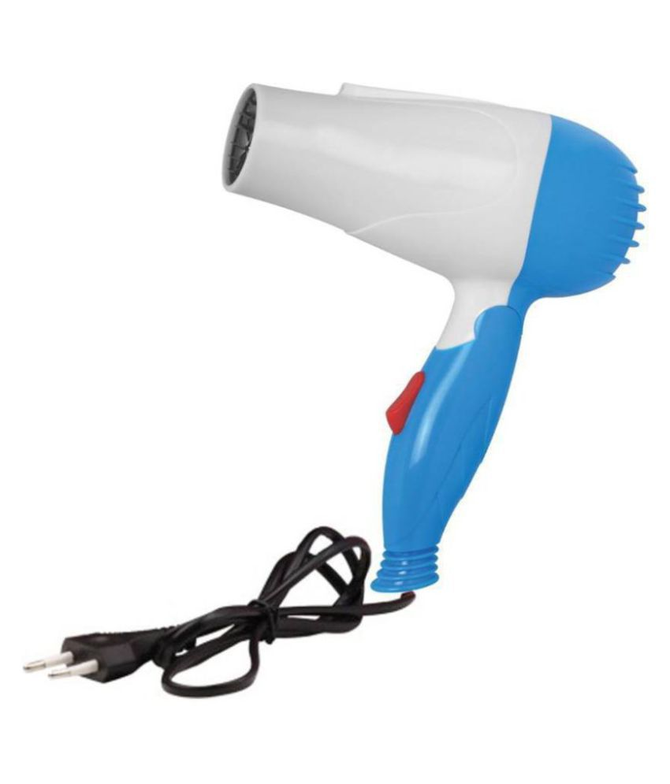
NOISE REDUCTION IN HAIR DRYER
PRODUCT USED:- Bentag NV-1290 Perfect Nova Hair Dryer
SPECIFICATIONS:- Power Consumption -1000 Watt ,
Voltage required - 220 volts.
supply line frequency – 50 Hz

Slide 3
WORKING PRINCIPLE OF HAIR DRYER
A hair dryer is an electromechanical device that blows hot air over damp hair to speed the evaporation of water to dry the hair.
Most hair dryers consist of electric heating coils and a fan (usually powered by a D.C Motor). The heating element in most dryers is a bare, coiled nichrome wire that is wrapped around mica insulators.
Nichrome is used because of two important properties: It is a poor conductor of electricity and it does not oxidize when heated.
When you plug in the hair dryer the circuit first supplies power to the heating element the current then makes the DC Motor spin which turns the fan
The air flow generated by the fan is directed down the barrel of the hair dryer over and through the heating element , the generated heat warms the air by forced convection and hot air streams out through the barrel.

Slide 4
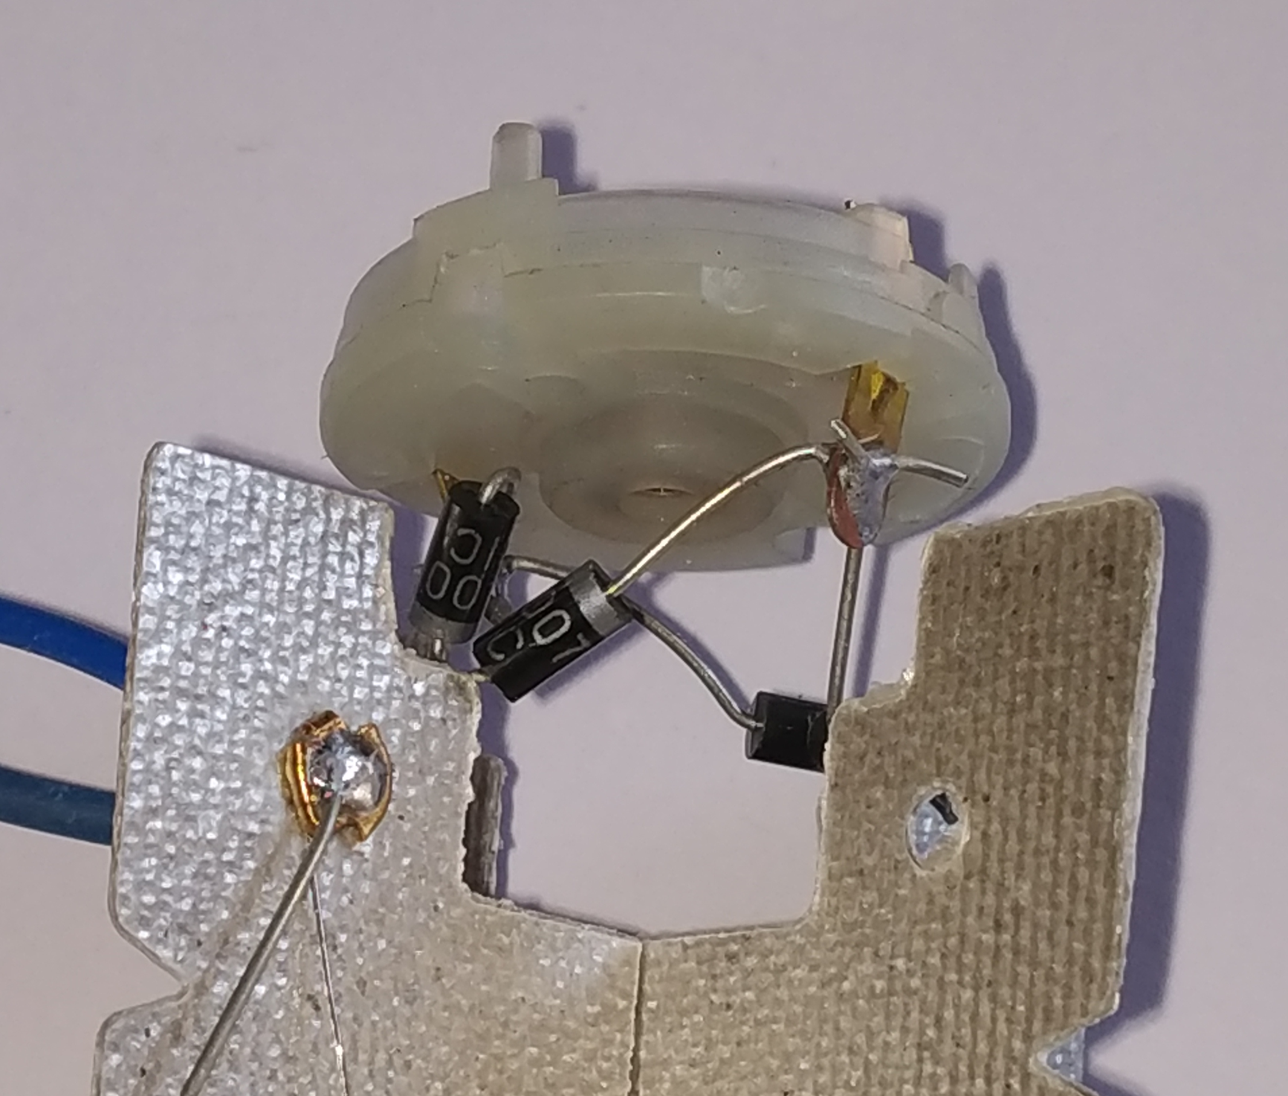
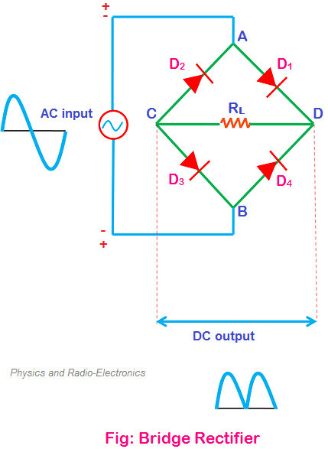
CONVERSION OF A.C TO D.C SUPPLY
Bridge rectifier
It is an electrical device that is used to convert alternating current in to direct current
The power supply available is 230volt A.C and by using rectifier we are converting to required D.C voltage.
DIODES

Slide 5
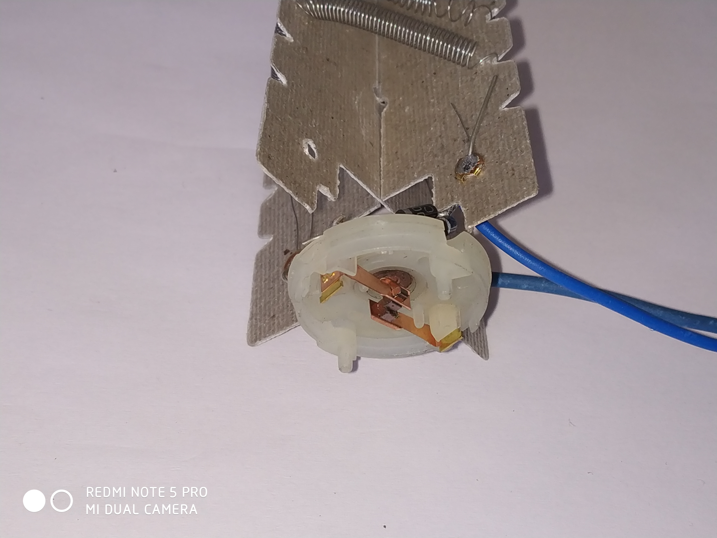
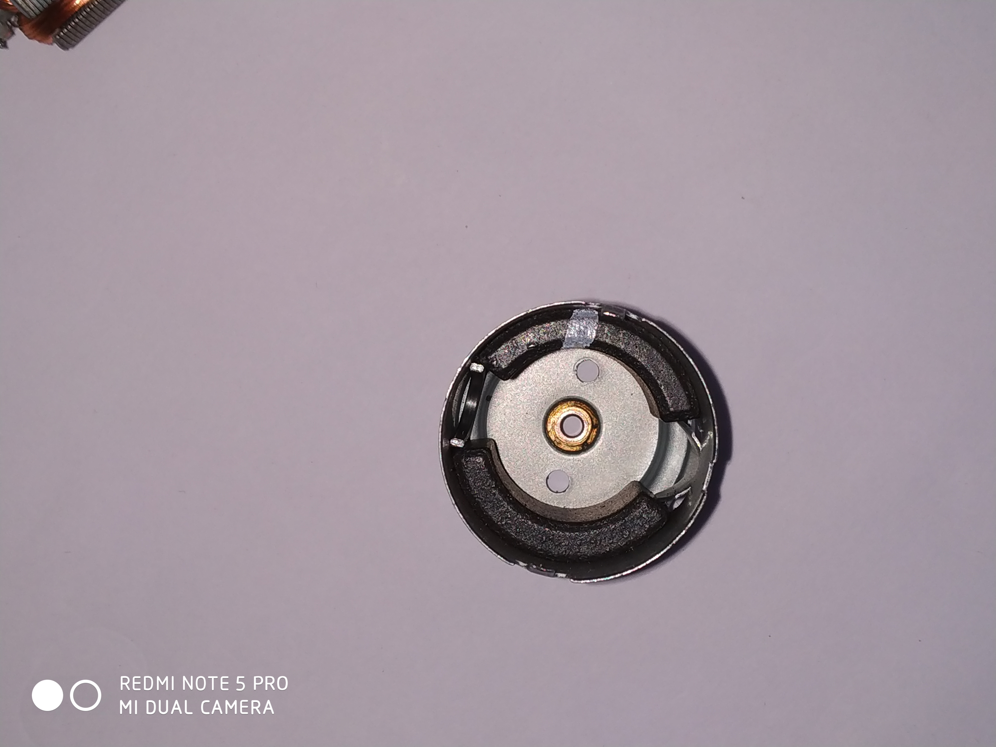
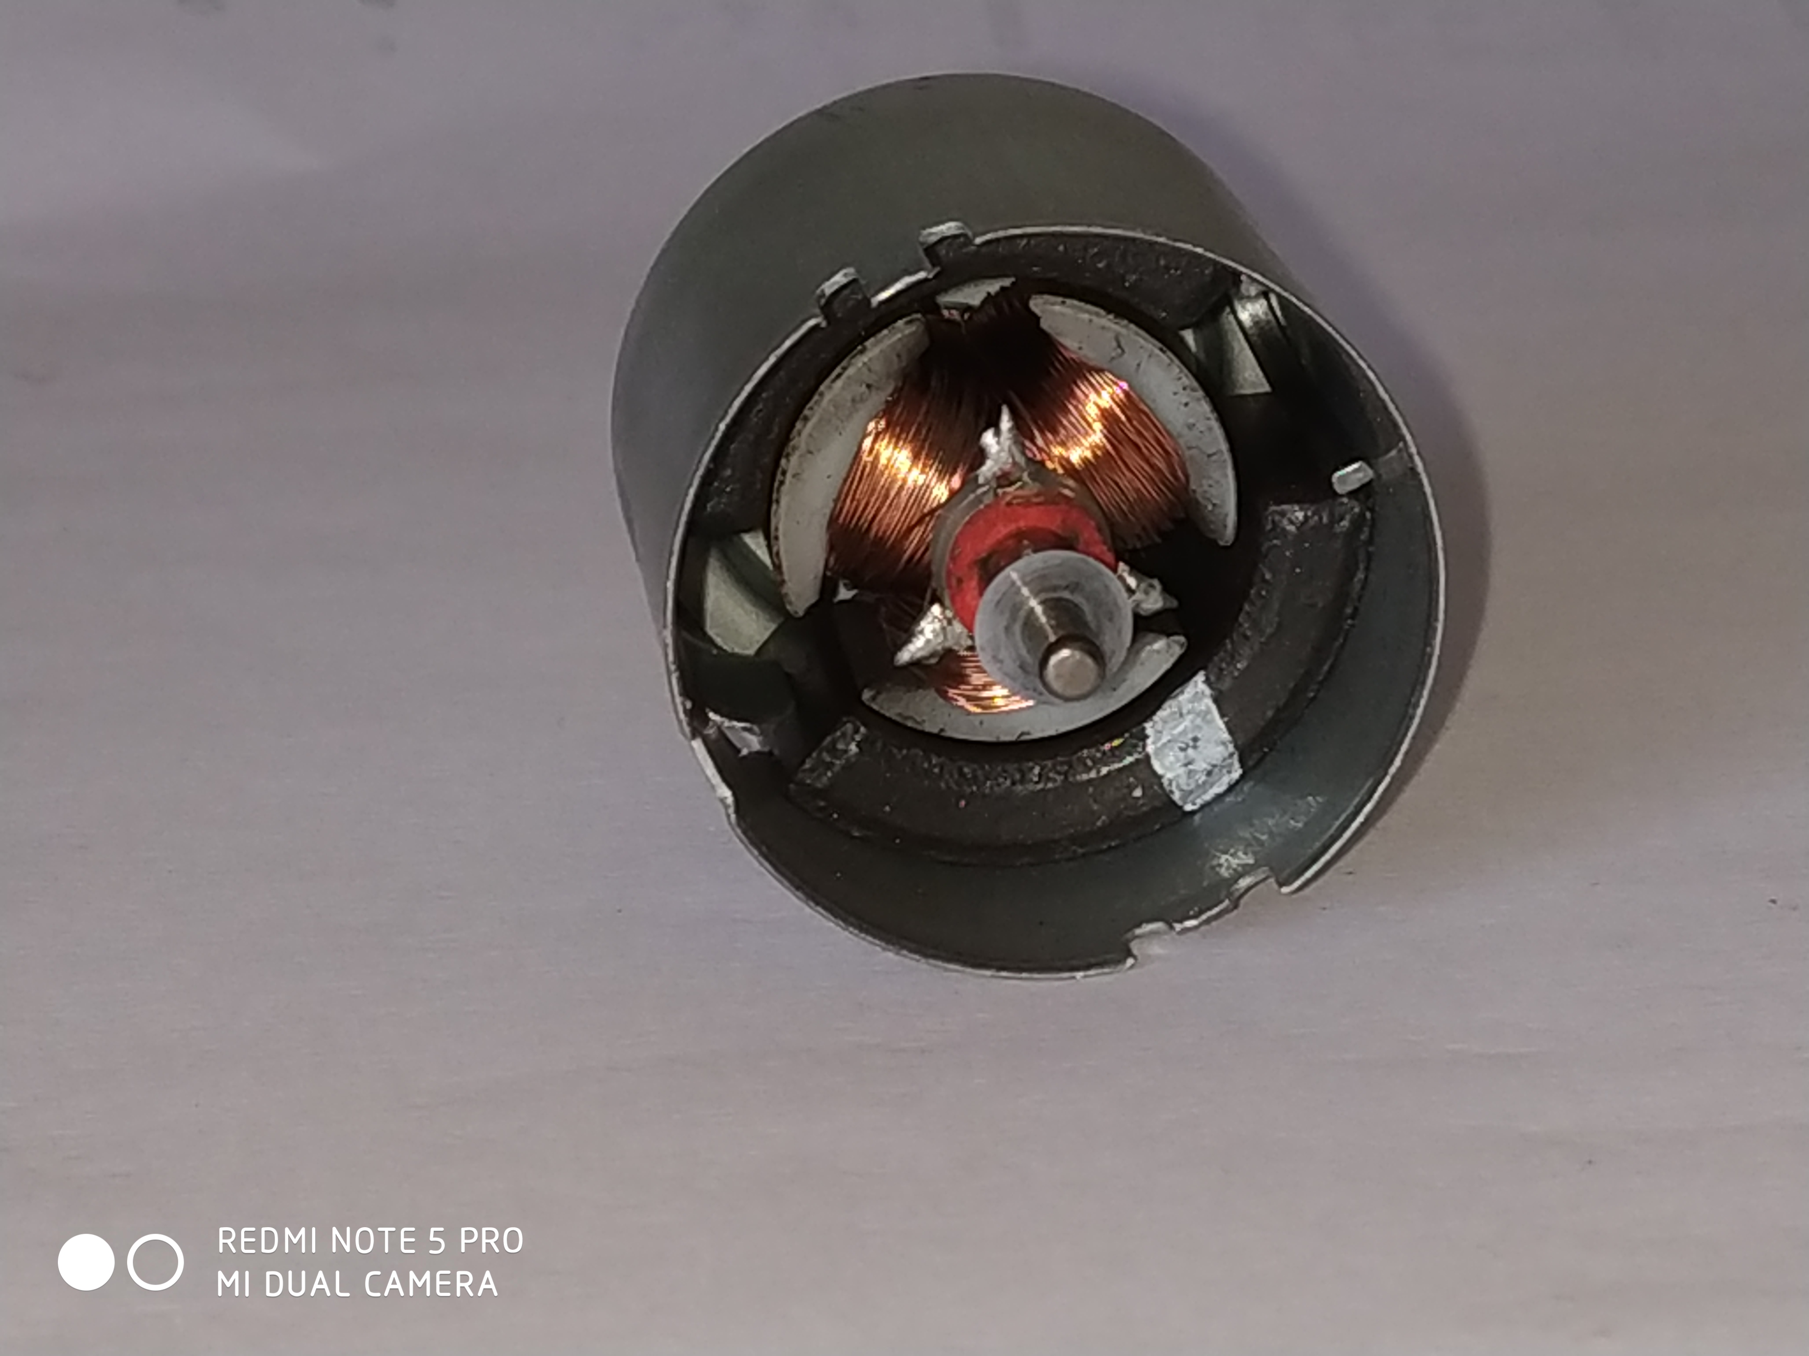
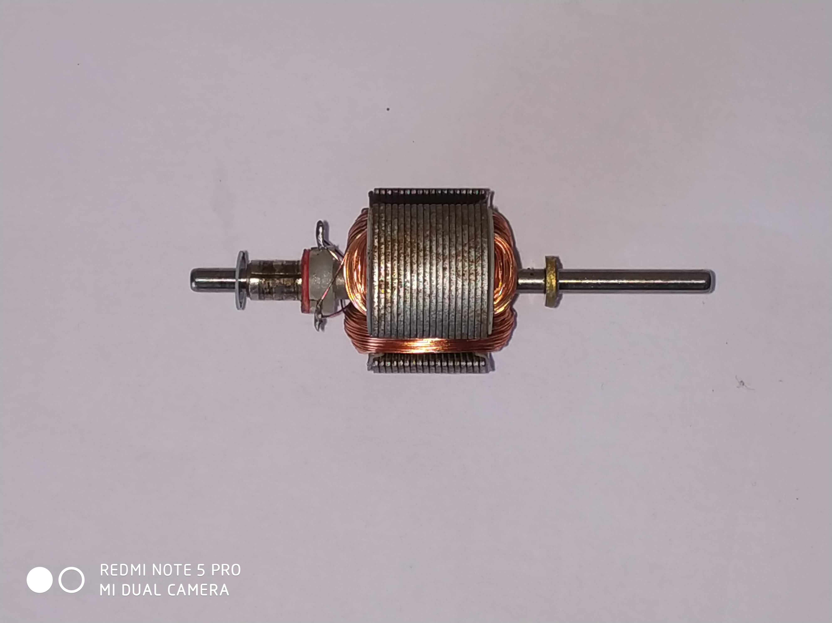
DISASSEMBLED VIEW OF D.C MOTOR
BRESHES
STATOR MAGNETS-(2)
COMMUTATOR
ROTOR COILS-(3)

Slide 6
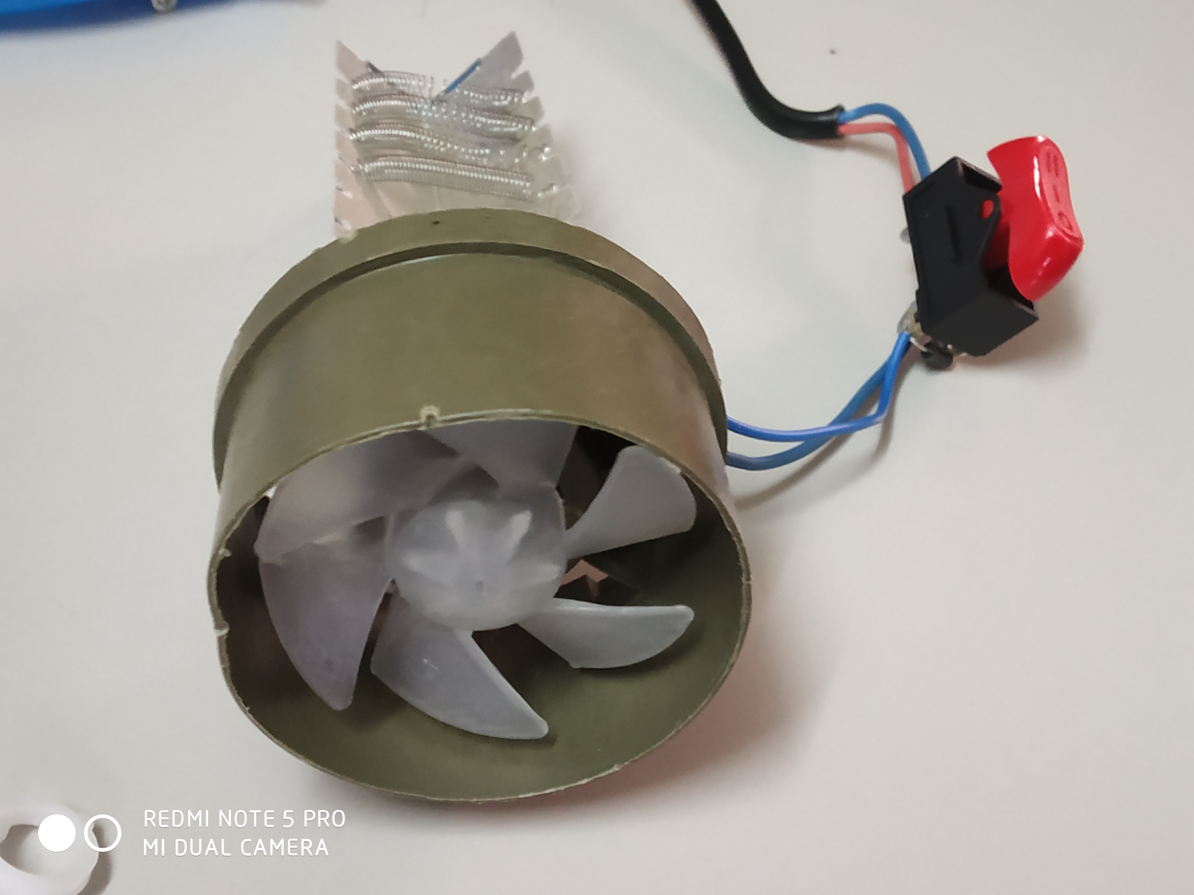
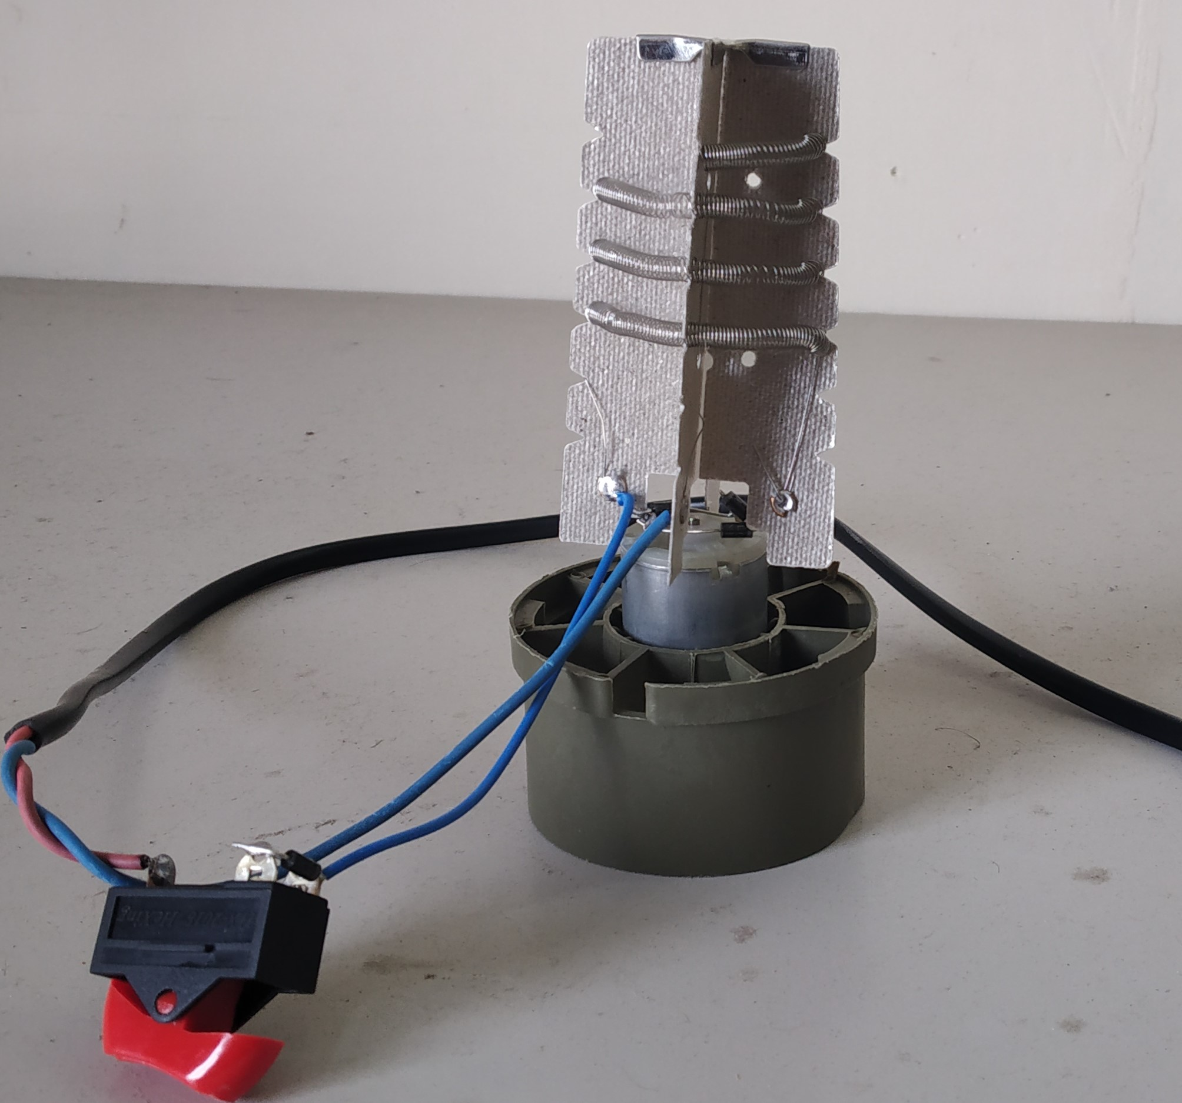
VARIOUS COMPONENTS OF HAIR DRYER
MICA INSULATOR
NICHROME WIRE
FIXTURE
DC MOTOR
FAN
SWITCH

Slide 7
VARIOUS SUBSYSTEMS
1) D.C MOTOR WITH FAN

Slide 8
MEASUREMENTS
TEST CONDITIONS :-
Back Ground Room SPL = 47.1 dB , 37.3 dBA.
Measurements are taken at a distance of 1 meter from the source at same level of height.
Time taken for measurements is 5 sec.

Slide 9
D.C MOTOR MEASUREMENTS:-
R.P.M of D.C Motor = 17230 RPM.(USING TACHOMETER).
Number of blades of Fan = 6.
BPF = Number of blades * rpm / 60
= 6*17230/60
= 1723 Hz

Slide 10
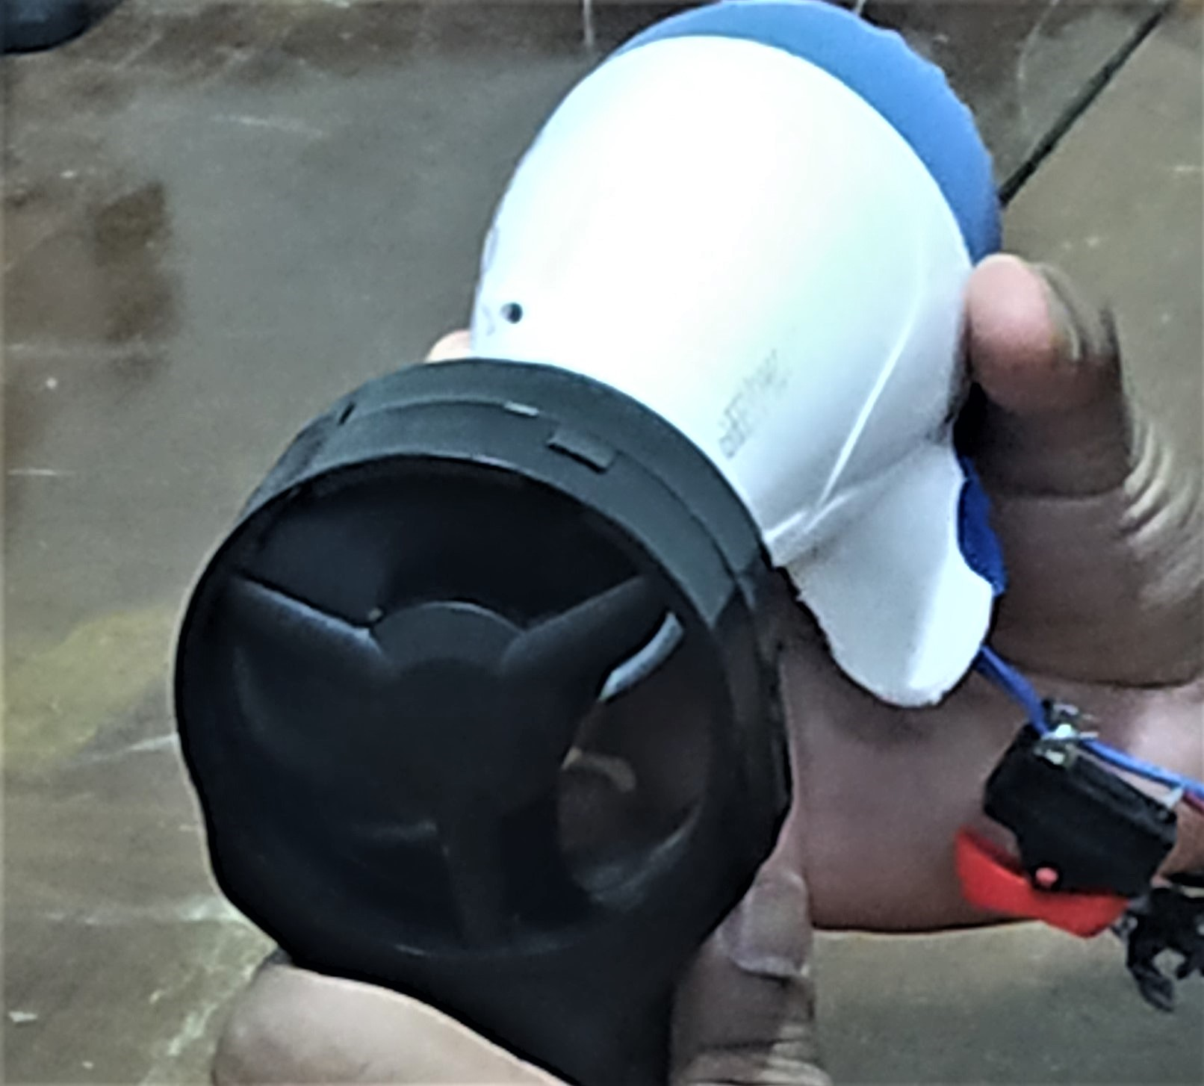
MASS FLOW RATE MEASUREMENT
Using hot wire anemometer we found out mass flow rate as 0.004 kg/s.
Velocity of air coming out of delivery of Hair dryer is 3 m/s.
Hair Dryer
Hot wire Anemometer

Slide 11
IDENTIFICATION OF NOISE SOURCES
WITHOUT ENCLOSURE:-
For D.C Motor without Fan , SPL = 71 dB.
For D.C Motor with Fan , SPL = 74 dB.
WITH ENCLOSURE:-
For D.C Motor with Fan, SPL =74 dB.
Primary Noise Source :- D.C Motor with Fan blades.

Slide 12
SOURCE RANKING
Lp Target=4 dB

Slide 13
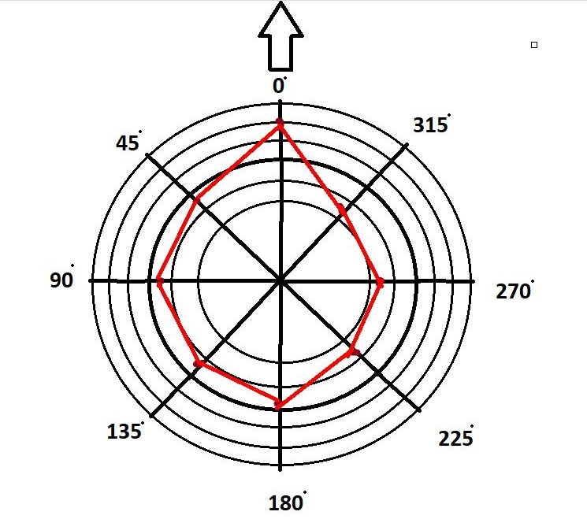
DIRECTIVITY CHART
DIRECTION | SPL(dB) | DIRECTIVITY INDEX
0 | 74 | 3.4
45 | 69.6 | -1
90 | 69.5 | -1.1
135 | 69.0 | -1.6
180 | 73.5 | 2.9
225 | 68.7 | -1.9
270 | 68.1 | -2.5
315 | 68.2 | -2.4
DELIVERY SIDE OF HAIR DRYER
SUCTION SIDE OF HAIR DRYER

Slide 14
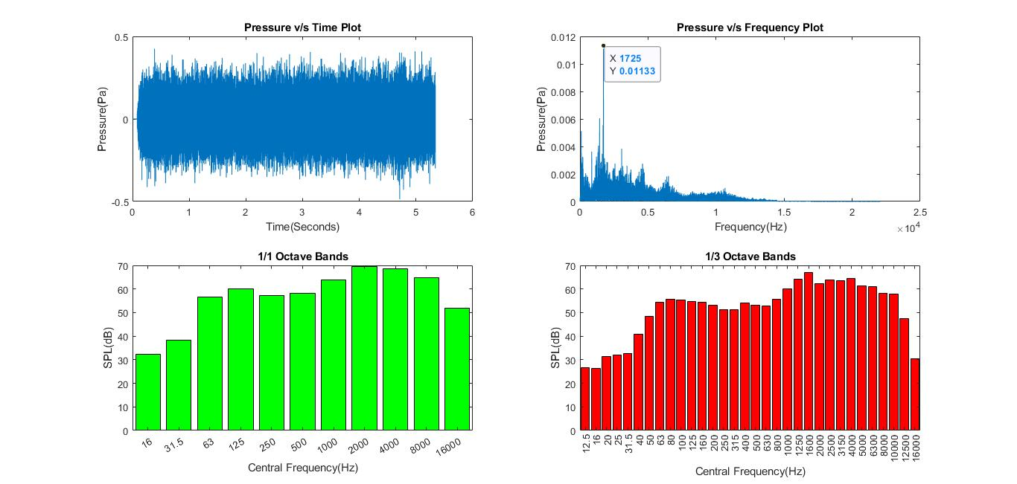
MATLAB RESULTS

Slide 15
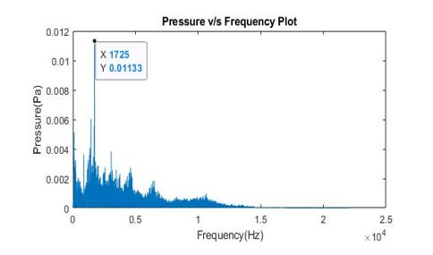
1*BPF
2*BPF
0.34

Slide 16
VIBRATION ANALYSIS (USING ACCELEROMETER)
228
328
585
685
785
785

Slide 17
IDENTIFICATION OF PATHS
STRUCTURE BORNE NOISE :-
As vibration analysis data is not matching with the Frequency spectrum of hair dryer so , we can say that contribution of structure born noise is less.
AIR BORNE NOISE:-
Due to rotation of Fan air particles get disturbed from its mean position and noise is generated.
We are getting peak value at 1725 Hz which is matching with blade passing frequency and another peak at second harmonic of BPF at 3440Hz.
Due to Turbulence Broad band spectrum is observed.

Slide 18
NOISE REDUCTION TARGET SETTING
POSSIBLE SOLUTIONS :-
To reduce air borne noise
Designing muffler at delivery part.
Attaching enclosure at suction port.
Since we are getting high frequency noise (1725Hz) . Accoustic material can be used effectively.

Slide 19
WHY MUFFLER DESIGN ?
Attaching enclosure at suction port will reduce the air intake which will reduce the mass flowrate.
Acoustic material is not used because hair dryer is having heating element and hot air is flowing in the direction of path.
Hence both possible way of noise control is not suitable for our product so, we decided to go for muffler design.

Slide 20
SELECTION OF MUFFLER TYPE
We are selecting Reactive muffler because it wont obstruct the flow of air and no dissipation of energy occurs.
Reactive muffler works on the principle of impedance mismatch by providing area change along the direction of flow .
We are selecting the conical muffler because it will increase the performance of hair dryer by increasing the velocity of air at the end of muffler .

Slide 21
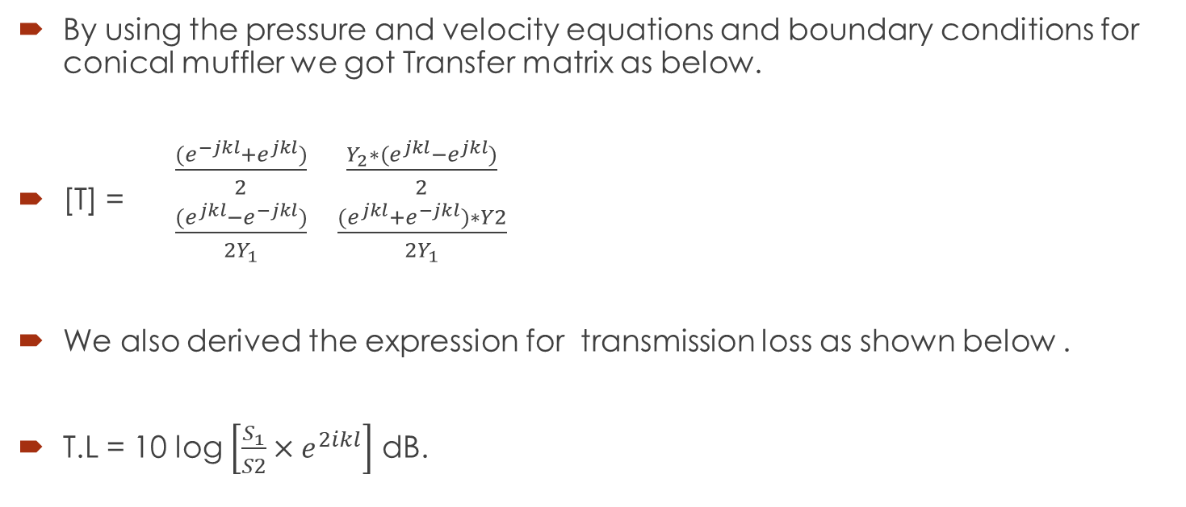
DESIGN OF CONICAL MUFFLER
By using the pressure and velocity equations and boundary conditions for conical muffler we got Transfer matrix as below.
[T] = $\begin{matrix}\frac{{(e}^{−jkl}+e^{jkl})}{2} & \frac{Y_{2}∗{(e}^{jkl}−e^{jkl})}{2} \\ \frac{{(e}^{jkl}−e^{−jkl})}{2Y_{1}} & \frac{{(e}^{jkl}+e^{−jkl})∗Y2}{2Y_{1}}\end{matrix}$
We also derived the expression for transmission loss as shown below .
T.L = 10 log $\left[\frac{S_{1}}{S2}×e^{2ikl}\right]$ dB.

Slide 22
CALCULATIONS OF CONICAL MUFFLER
1
2
D1
D2
L
Diameter D1 = 3.8 cm (Dia of Hair dryer delivery pipe)
TL = 4dB . (Target reduction )
Wave number k = 31.8 / m. (at frequency f =1723Hz)
We found out the optimum diameter for minimum length as D2 = 2.4 cm and from Geometry of hair dryer the cone angle we found is 8 degree, we found minimum length of muffler as L=4.48cm.

Slide 23
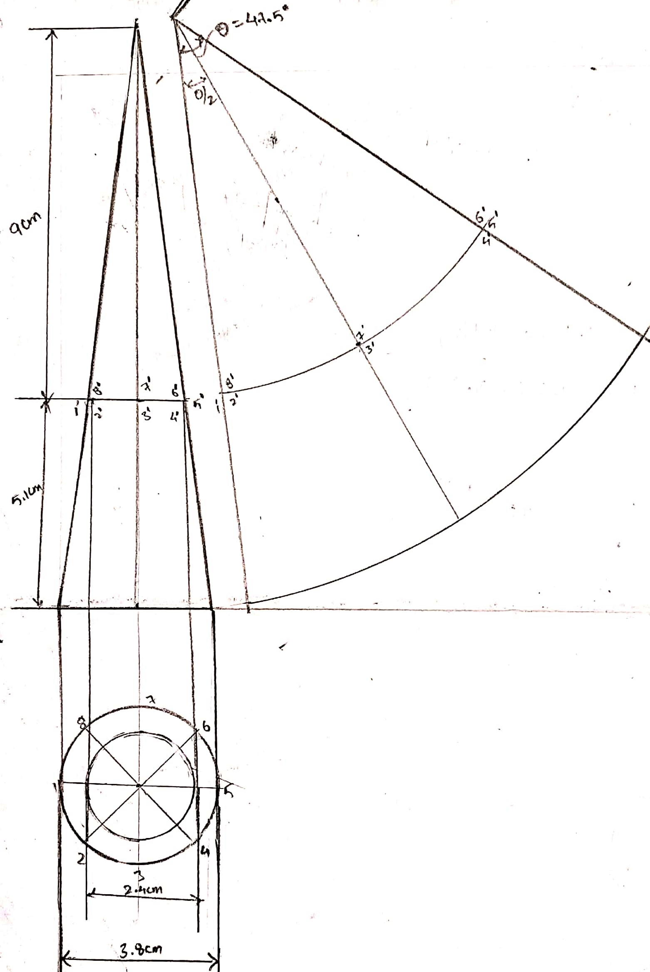
DEVELOPMENT OF CONICAL SURFACE

Slide 24
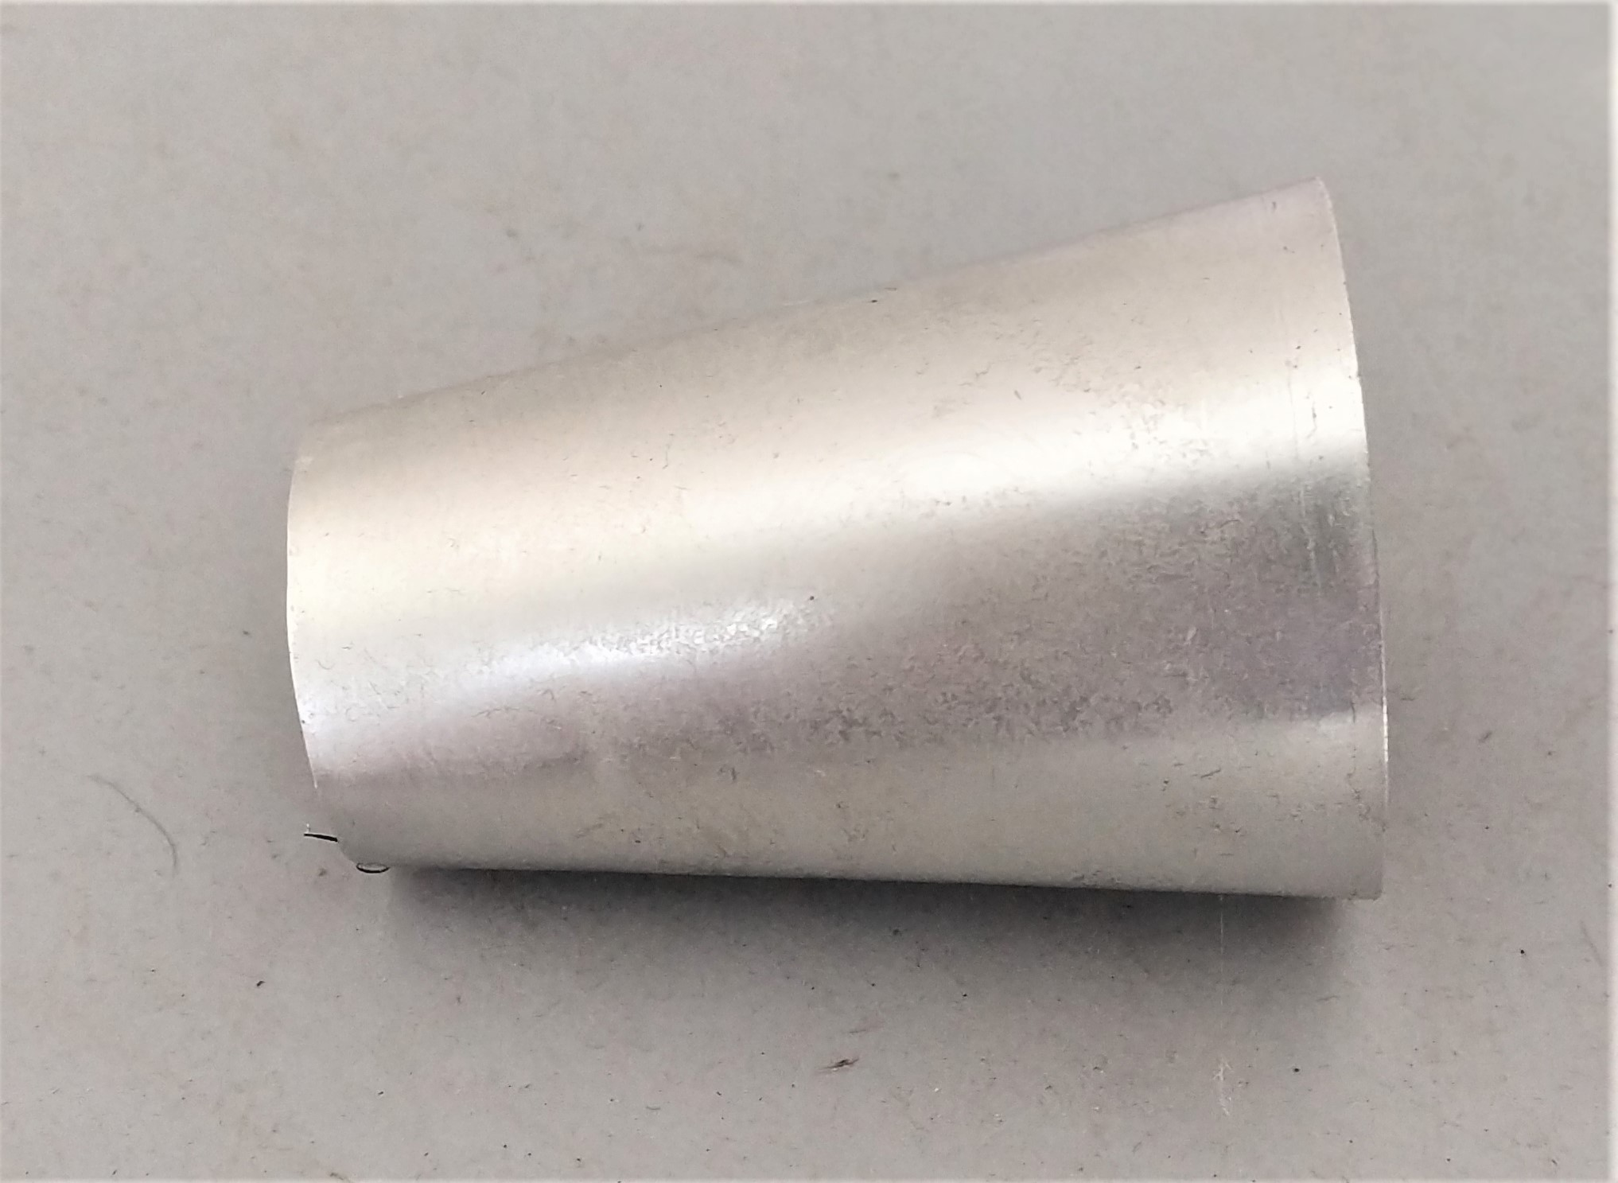
MUFFLER
By using Aluminium metal sheet with the truncated cone dimensions we fabricated the muffler as shown below.

Slide 25
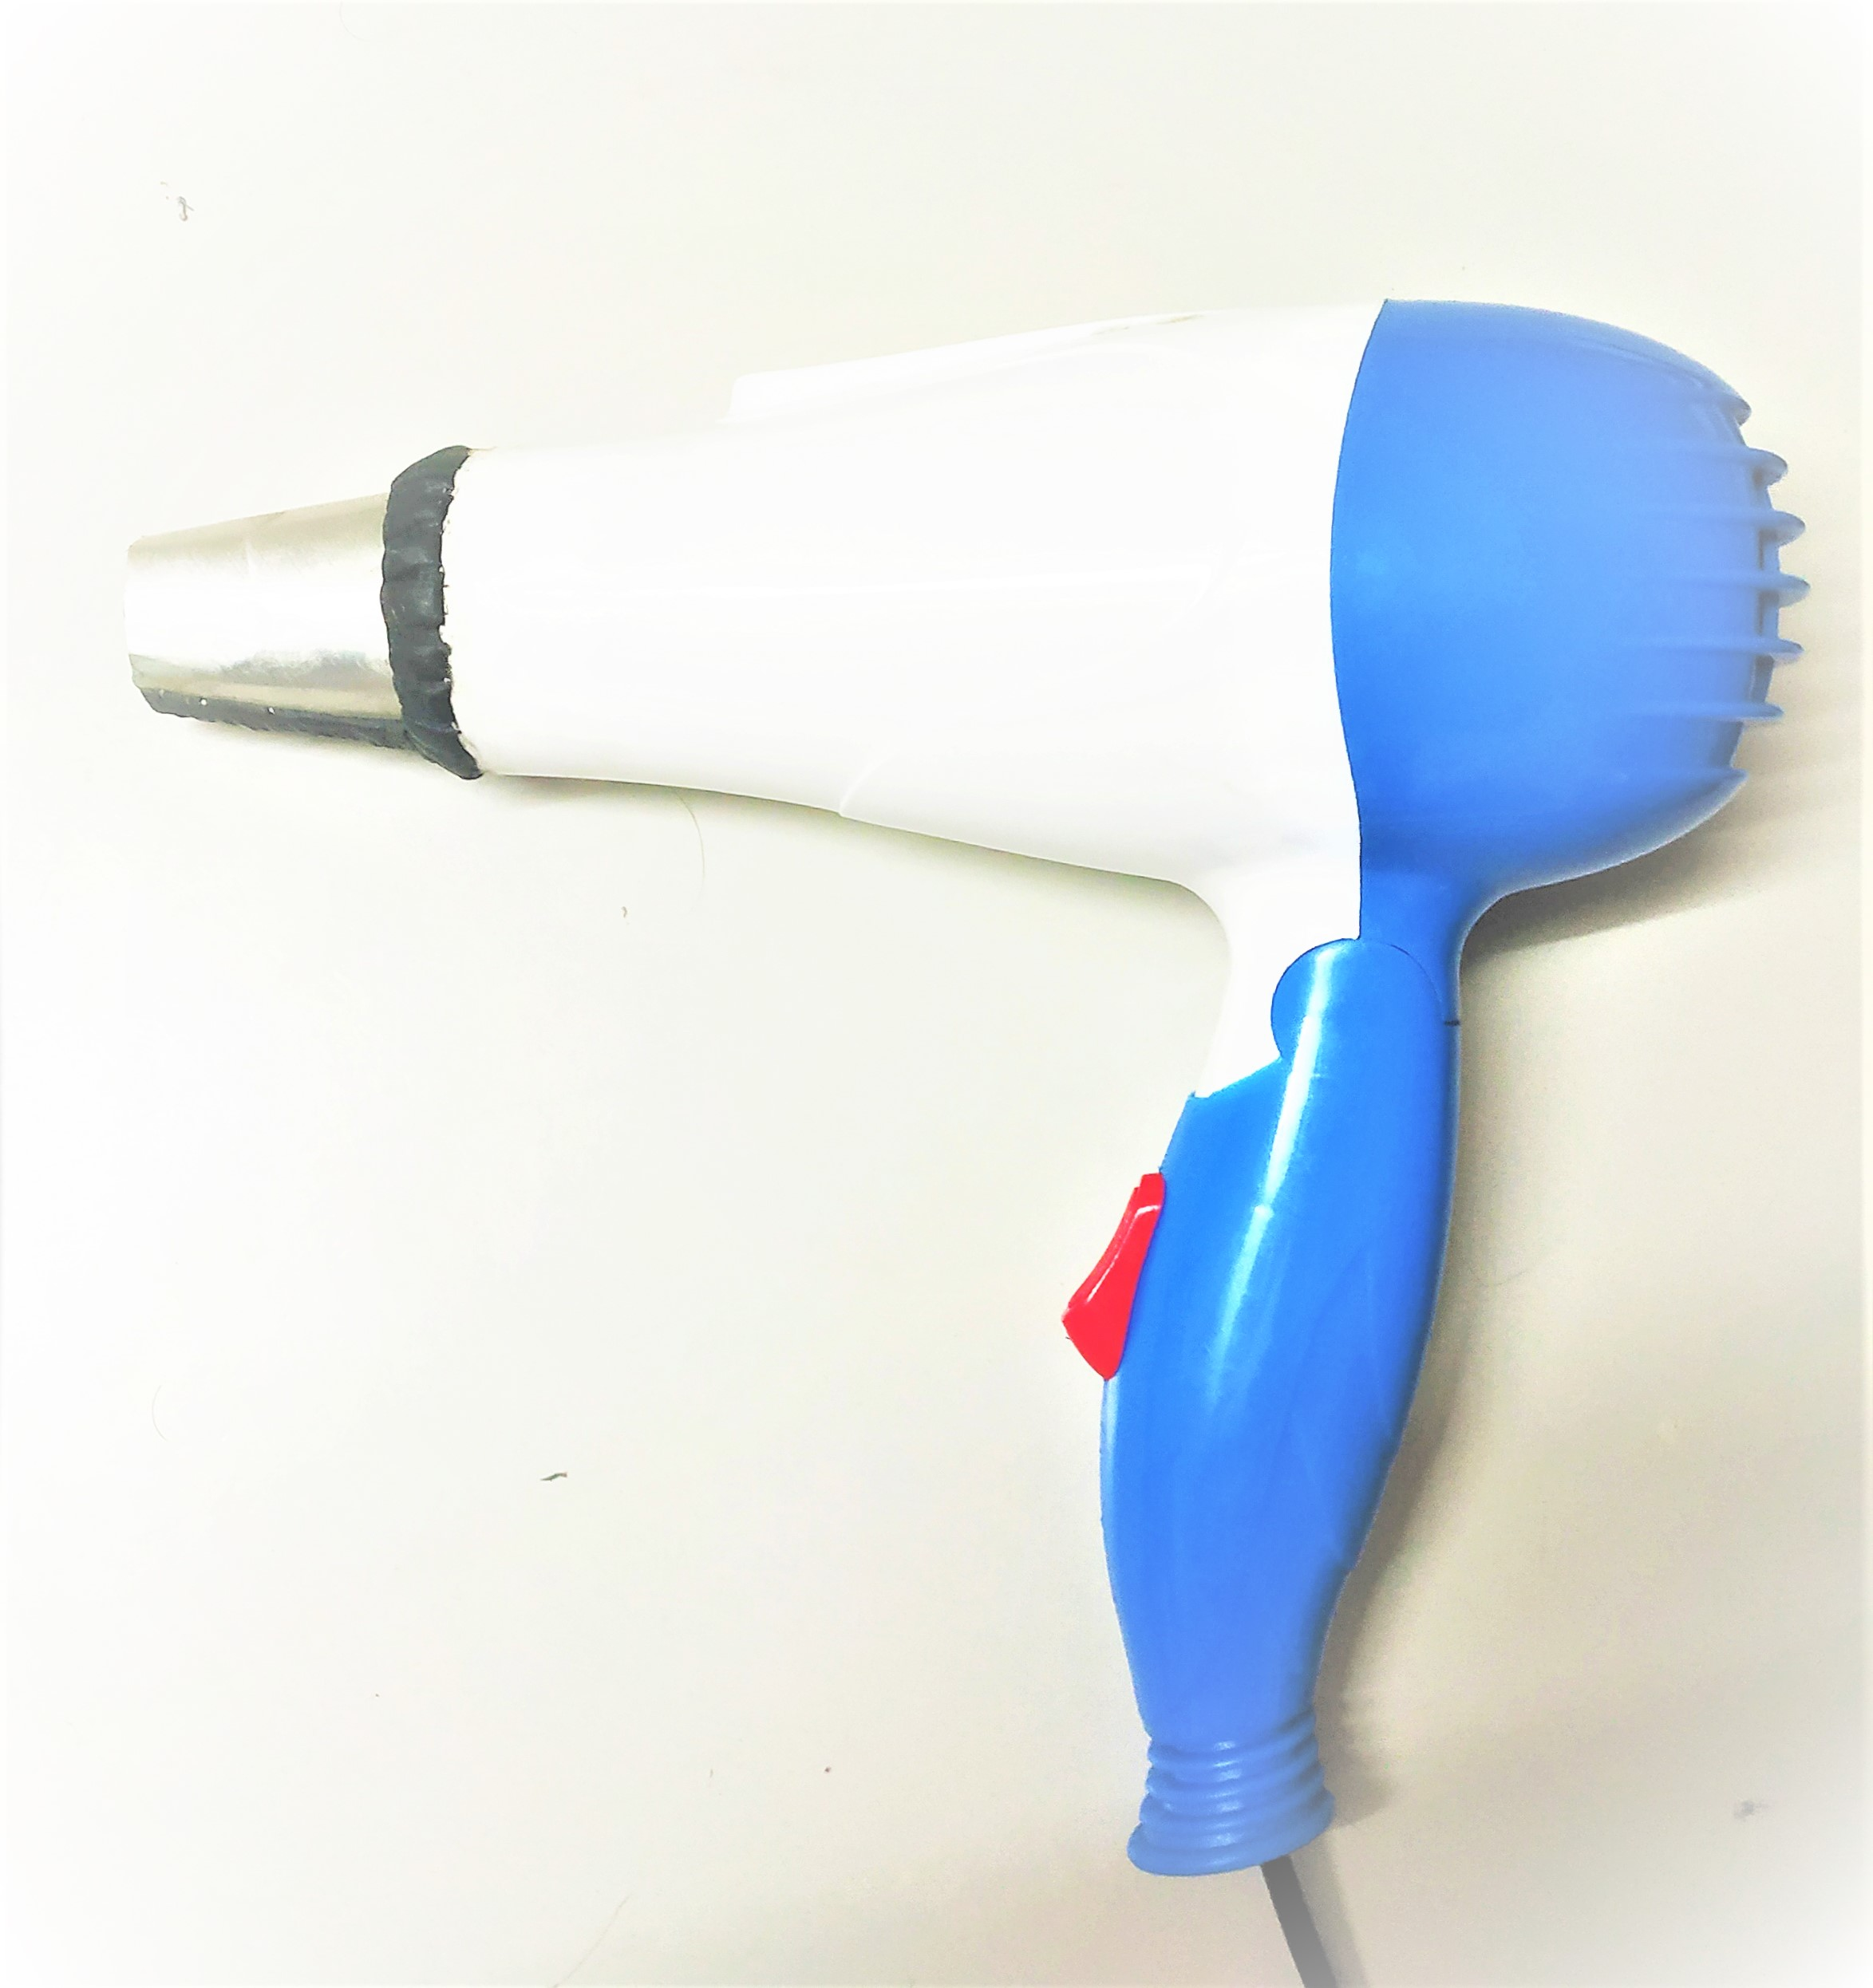
MODIFIED HAIR DRYER WITH MUFFLER
MUFFLER

Slide 26
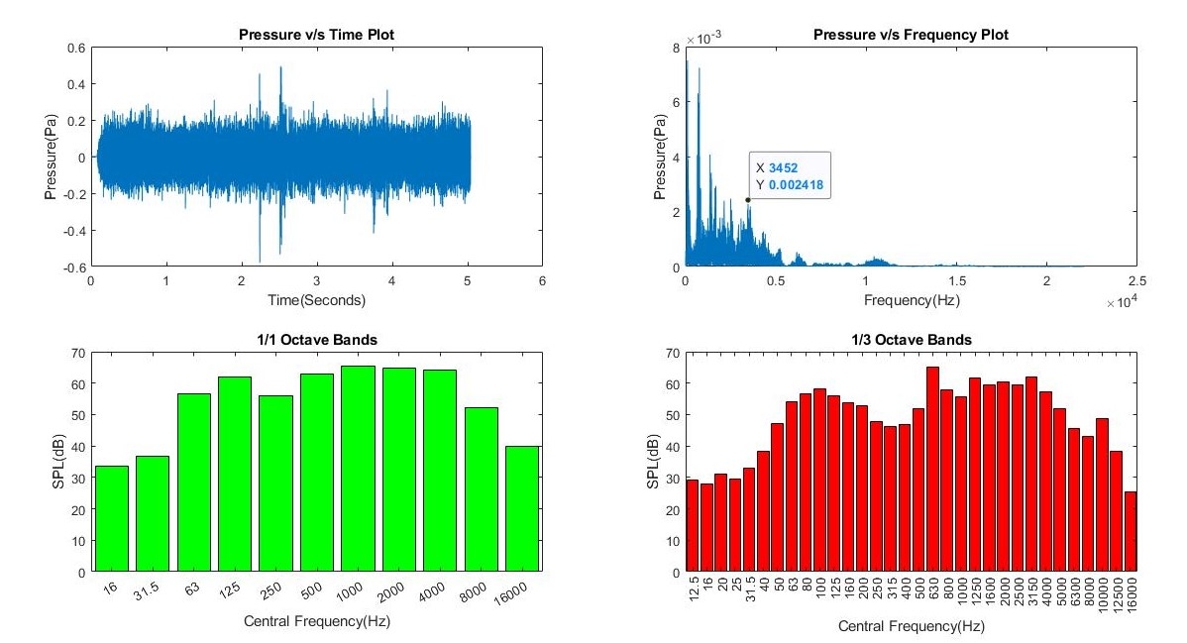
RESULTS:-
MATLAB RESULTS
2*BPF

Slide 27
COMPARISOIN OF RESULTS
1*BPF
2*BPF

Slide 28
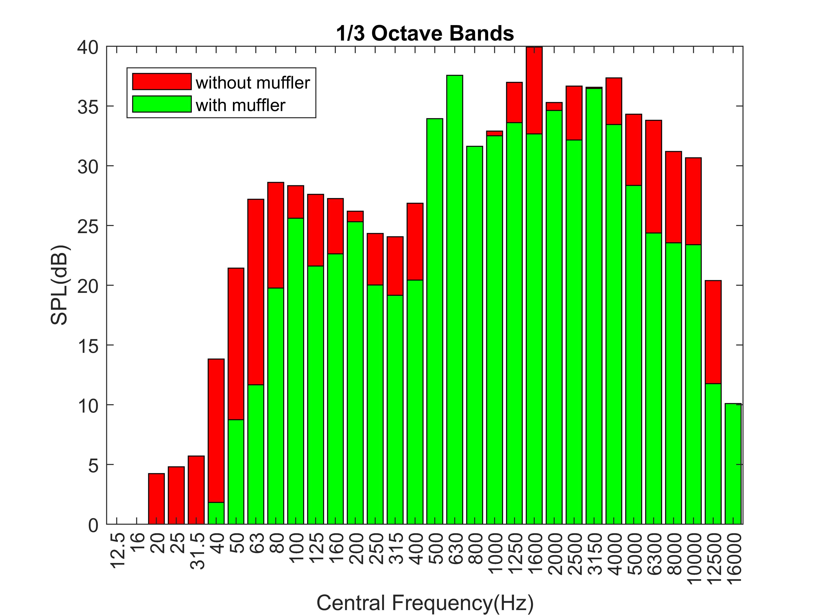
Contd…

Slide 29

AUDIO SAMPLES
WITHOUT MUFFLER
WITH MUFFLER

Slide 30
OBSERVATIONS:-
After attaching muffler total SPL = 71dB.
We got 3dB reduction .
We observed that peak in first BPF is eliminated .
Amplitude of second BPF is reduced by 0.002 Pa.
After attaching muffler we observed peaks at lower frequency range this may be due to breakout noise.

Slide 31
FUTURE WORK
As muffler surface is getting heated during operation we will provide insulation material on the surface of muffler .
Elimination of brake out noise

Slide 32
REFERENCES:-
Creative Means of Making Acoustic Measurements Inexpensively with Hair Dryer Noise Reduction as an Example Conference Paper · June 2014
Philippe K. and Pierre J., Hasselt, BE, European patent application for “Add on silencer for hairdryer”, Application number: 09177178.2, filed: November 26, 2009.
Altamore, N., United States patent for “Hair drying device with reduced sound emissions”, Patent Number: 6,148,537, Patent date: November 21, 2000.

Slide 33
THANK YOU

